Slide 1
Chapter 11
Sikhism
Sikhs now prefer Sikhi as the name of their religion because that’s how they say it in their language

Slide 2
Sikhi
I am using the term ‘Sikhi’ within this Powerpoint and in my lecture, as a more accurate name for the beliefs and life of Sikh people. The word ‘Sikhism’ was coined by the British Raj, it was not a term Sikhs used themselves. Professor Arvind-Pal Singh Mandair describes the term as a ‘colonial construct.’ The word ‘Sikh’ comes from the Punjabi verb ‘Sikhana’, meaning ‘to learn’. Thus a ‘Sikh’ is one who learns.
Notes:
(A Singh Mandair, 2013: p. 5).

Slide 3
Sikhi
The term ‘Sikhi’ as opposed to ‘Sikhism’ implies a continuous state of learning and engagement, rather than a box into which people can be placed. Sikhi is not an ‘ism’, it is a way of life. The indigenous terms sikhi, gursikhi, gurmat “teachings of the Sikh Gurus” or dharam “duty, righteousness, law, sacred duty” are extensively used by Sikhs who speak Punjabi.
Notes:
(A Singh Mandair, 2013: p. 5).

Slide 4
Learning Objectives
11.1 Describe the life and teachings of Guru Nanak.
11.2 Summarize the development of Sikhi during the time of the Gurus.
11.3 Outline what happened to Sikhi in India after the death of Guru Gobind Singh.
11.4 Identify the central beliefs of Sikhism.
11.5 Explain how the teachings of Sikhism are put into practice.
11.6 Discuss the tensions and challenges faced by Sikhism in India and the diaspora.

Slide 5
“The universal kinship of humankind found in Guru Granth Sahib, which is the living Guru of the Sikhs, serves as a model for harmony and world peace.”
Sheena Kandhari
Notes:
Sheena Kandhari, personal communication, January 29, 2012.

Slide 6
Introduction
A great teacher emerged from northern India in the fifteenth century. His name was Guru Nanak and his followers were called Sikhs (disciples, students, seekers of truth). He was succeeded by nine enlightened Gurus ending with Guru Gobind Singh (1666–1708).
Sikhism is a vibrant religion and the fifth largest of all world religions. Its spiritual essence is virtually unknown outside of India and in its diaspora (dispersed communities).

Slide 7
Introduction
In the past, scholars have characterized Sikh beliefs and practices as a Hindu offshoot or synthesis of Hindu and Muslim traditions of northern India. However, Sikhism is independent, with its own unique quality, revelation, and history.
Sikhism does not actively seek new converts, and Sikhs typically do not think of their faith as yet another sectarian religion.
Rather, they understand their path as an expression of the universal truth within and beyond all religions.

Slide 8
11.1 Guru Nanak
The founder of this tradition is Guru Nanak, who lived from 1469–1539 CE.
He was born in the Punjab, a region of northwestern India situated on the route many outside invaders took into the Indian subcontinent.
The Punjab was home to both Muslims and Hindus.

Slide 9
11.1 Guru Nanak
Guru Nanak gave shape to Sikhism in an environment where the sant movement was challenging conventional religious beliefs and practices. Sants, or “holy people,” were northern Indian poets who rejected outward forms of ritual expression in favor of deep internal devotion and repetition of the name of God. They were also critical of caste distinctions.

Slide 10
11.1 Guru Nanak
Sikh traditions about the life of Guru Nanak are from texts called janam-sakhis (“birth witnesses”), which were probably first written down in the seventeenth century and reflect events that are important to believers (e.g., miracles) but are not necessarily historically verifiable.

Slide 11
11.1 Guru Nanak
Nanak is said to have been of a contemplative nature from childhood; although he married and worked as an accountant, he was most focused on spiritual practice.
At the age of thirty, he had a transformative experience after immersing himself in a river for several days, only to reemerge unharmed and glowing. According to some legends, he was taken to the presence of God and ordered to go back into the world to redeem it from Kali Yuga (the darkest of ages).

Slide 12
11.1 Guru Nanak
Sikh legend reports that Nanak subsequently began traveling and teaching, arguing that distinctions between Hindu and Muslim were unimportant.
Guru Nanak taught three central concepts: working hard to earn a living rather than withdrawing from society, sharing one’s wealth with the needy, and remembering God’s name at all times.

Slide 13
11.1 Guru Nanak
Nanak eventually settled with his family as a farmer.
His followers, known as Sikhs, contributed to a free community kitchen (called a langar) that served food without recognizing caste distinctions. Guru Nanak introduced social order based on equality, justice, and service in devotion to One God.

Slide 14
11.1 Guru Nanak
Sikh legend reports that before Guru Nanak died, Hindu and Muslim followers argued over who would dispose of his body. He told Muslims to place flowers on one side of his body and Hindus to place flowers on the other side of his body; whichever side stayed fresh the next day indicated who could bury or cremate him. The next day they raised the sheet and his body was gone and all the flowers were still fresh, leaving behind only a fragrance of his being.

Slide 15
11.2 The succession of Gurus
There were nine gurus after Guru Nanak, all of whom were understood to transmit his spiritual light.
Guru Nanak designated Guru Angad (1504–1552) as his spiritual successor. Angad (meaning “limb of his body”) continued the tradition of the community kitchen, or langar.
He became powerful and healed incurable diseases like leprosy.
Guru Angad was also the model of humility and service to the poor.

Slide 16
11.2 The succession of Gurus
The Third and Fourth Gurus, Amar Das and Ram Das, developed organizational structures for the growing Sikh Panth (pronounced “punt”), or community.
Ram Das established the city of Amritsar, where the Fifth Guru, Arjun Dev (1536–1606), built the Golden Temple, Sikhism’s most sacred shrine.
o He also compiled the Adi Granth (“original holy book,” now known as the Guru Granth Sahib, which includes compositions by later gurus) from the hymns of the Sikh gurus as well as Hindu and Muslim saints.

Slide 17
11.2 The succession of Gurus
Emperor Akbar visited the Third, Fourth, and Fifth Gurus and was pleased with their teachings. His son and successor, Jehangir, was so jealous of Guru Arjun Dev’s popularity that he had the Guru tortured and executed on a false charge.
Guru Hargobind (1595–1644), the Sixth Guru, established a Sikh army to defend the weak of all religions against tyranny. He carried two swords, one symbolizing temporal power, the other spiritual power.

Slide 18
11.2 The succession of Gurus
The Seventh Guru, Har Rai (1630–1661), was a pacifist who advocated service to humanity.
The Eighth Guru, Har Krishnan (1656–1664) became guru at the age of five and died when he was eight.

Slide 19
11.2 The succession of Gurus
The Ninth Guru, Tegh Bahadur (1621–1675), was martyred.
According to Sikh tradition he came to the aid of Hindus who were facing forced conversion to Islam; despite rejecting Hindu religious belief and practice, he wished to defend religious freedom.
He was imprisoned by the Mughal emperor Aurangzeb and then publicly executed.

Slide 20
11.2 The succession of Gurus
Guru Tegh Bahadur’s son, Gobind Singh (1666–1708), became the Tenth Guru.
Sikh tradition reports that in 1699, he called his followers to a special assembly and asked for five volunteers willing to offer their heads to protect religious ideals.

Slide 21
11.2 The succession of Gurus
Each of the five was taken into a tent; as each one entered, Guru Gobind Singh came out shortly afterward with a bloody sword.
Some accounts state that the blood came from a goat; others report that Guru Gobind Singh killed but then resurrected the men, who were thenceforth known as the Five Beloved Ones.

Slide 22
11.2 The succession of Gurus
Guru Gobind Singh then established a new rite of initiation that involved using amrit, water stirred with a double-edged sword to make the Sikhs heroes and mixed with sugar to make them compassionate.

Slide 23
11.2 The succession of Gurus
Guru Gobind Singh first initiated the Five Beloved Ones and then had them initiate him.
Men who undergo this initiation take the surname Singh (“lion”) and women who do so take the surname Kaur (“princess”).
These initiates form the Khalsa (“pure ones”).

Slide 24
11.2 The succession of Gurus
Khalsa male initiates are to wear five symbols (known as the Five Ks because in Punjabi each begins with the letter “k”):
uncut hair worn under a turban
a comb to keep the hair tidy
a steel bracelet
drawstring underbreeches,
and a sword.

Slide 25
11.2 The succession of Gurus
Women may adopt some of the five symbols but typically do not wear a turban.
There are many interpretations of the significance of the Five Ks; especially important is that the uniform symbols indicate a spirit of equality among Sikhs regardless of caste or socioeconomic status.
The sword is often a metaphor for divine wisdom that cuts through ignorance and egocentrism.

Slide 26
11.2 The succession of Gurus
Sikh tradition also records that Guru Gobind Singh established a disciplinary code for the Khalsa, which included rules against tobacco use, adultery, and consumption of meat slaughtered in Muslim fashion.
Before his death, Guru Gobind Singh declared an end to the human succession of Gurus and declared that the Guru’s authority would thereafter reside in the Adi Granth.

Slide 27
11.2 The succession of Gurus
Thenceforth, the Adi Granth, which now included hymns of the later gurus, became known as the Guru Granth Sahib.
The Sikh Gurus did not instruct their followers to convert others, but the Udasis, established by Guru Nanak’s son Baba Siri Chand, helped spread the message of Sikhism.

Slide 28
11.3 Sikh rule and India’s independence movement
Sikhs gained political power during the early nineteenth century but were conquered by the British in 1849.
Sikhs were prominently involved and made significant contributions in the struggle for independence from the British.
Many Sikhs were examples of nonviolent resistance to oppression despite their military abilities.

Slide 29
11.3 Sikh rule and India’s independence movement
The British left India in 1947, creating a new nation of India and Pakistan. The partition of Indian impacted the Sikhs, and approximately two-thirds of the Punjab, the homeland of the Sikhs, became part of West Pakistan.
Two million Sikhs who lived there were forced to migrate to the eastern border under extreme conditions of hardship. They even left behind certain sacred sites.
Resistance to oppression has remained the hallmark of Sikhism.

Slide 30
11.4 Central beliefs
Sikhs’ major focus is loving devotion to one God, whom Sikhs recognize as the same One who is worshiped by different names around the world. God is formless, beyond time and space, the only truth, the only reality.
This boundless concept was initially set forth in Guru Nanak’s Mul Mantra (basic sacred chant), which prefaces the Guru Granth Sahib, and JapJi (the first morning prayers of Sikhs).

Slide 31
11.4 Central beliefs
Sikhs often refer to God as Sat (“truth”) or Ik Onkar (“One Supreme Being”).
Guru Gobind Singh offered a litany of praises of the boundless, formless One in his composition, Jaap Sahib.
According to Sikh belief, God’s light shines through the Gurus and the Guru Granth Sahib, and indeed all of creation, in which Nam or the Holy Name of God dwells.

Slide 32
11.4 Central beliefs
Sikhism shares with Hinduism belief in karma and reincarnation; for Sikhs, the ultimate goal is mystical union with the divine.
Sant-sipahis (saint-soldiers) are pledged to protect freedom of all religions.
Service is highly valued and especially practiced by the group of Sikhs known as Seva Panthis.
Sikhs are to recognize God in the world through work, worship, and charity.
Ego is considered a major obstacle to God realization.

Slide 33
11.4 Central beliefs
There have been respected women in the tradition who have fought to defend the faith.
Still, preference for sons over daughters persisted among Sikhs; in 2001, the chief Sikh authorities issued an order that anyone practicing female feticide would be excommunicated.

Slide 34
11.4 Central beliefs
Guru Gobind Singh developed five conditions for “righteous war”: military means may be used only as a last resort; battle must be conducted without enmity or desire for revenge; territory should not be taken or captured property retained; troops must be committed to the cause, not mercenaries, and they must not smoke, drink, or abuse opponents’ women; minimal force should be used, with hostilities ending as soon as the objective is attained.

Slide 35
11.5 Sacred practices
To be a true Sikh is to live a very disciplined life of surrender and devotion to God.
Sikhs are to practice constant inner repetition of God’s name.
Those who dedicate themselves to a committed life of prayer and to abstinence from drugs, alcohol, and tobacco and who renounce anger and criticism are called Khalsa initiates.

Slide 36
11.5 Sacred practices
Because the lifestyle is so rigorous, most do not choose this path.
A Khalsa or pure one strives to vanquish the five evils of lust, anger, greed, attachment, and ego.

Slide 37
11.5 Sacred practices
Sikh institutions include the langar, freely offered to all who come to the gurdwara (building where the Guru Granth Sahib is enshrined and public worship takes place).
The Sikh congregation is known as the sangat; there is no priestly class.
There is no caste separation in worship, although men and women usually sit separately.

Slide 38
11.5 Sacred practices
Sikhs are encouraged to donate a percentage of their income to community welfare.
There are both morning and evening prayers.
The hymns of the Guru Granth Sahib are often chanted or sung; this is known as kirtan.
The Guru Granth Sahib is treated with great respect. It is placed on a platform, and a whisk may be waved over it.

Slide 39
11.5 Sacred practices
For special occasions, Sikhs may commission an Akhand Path, or continuous reading of the entire text.
Some gurdwaras, including the Golden Temple in Amritsar, have traditionally allowed only men to read publicly from the Guru Granth Sahib.
In 1996, the central body regulating gurdwaras ruled that women should be allowed to read publicly as well.

Slide 40
11.6 Sikhism today
Although Sikhs constitute less than 2 percent of India’s population, they have played a leading role in government. Dr. Manmohan Singh became India’s first Sikh prime minister in 2004.
The Punjab remains the heart of Sikhism, although this region of the Indian subcontinent was partitioned when the British left India in 1947.
Two-thirds of the Punjab went to Pakistan, and many Sikhs living there at the time migrated to the Indian side of the Punjab (and elsewhere) amid great hardship and violence.

Slide 41
11.6 Sikhism today
Although relations between Sikhs and Hindus have generally been good, there have been violent clashes between them in recent years.
Sikh separatists have called for an independent Sikh state to be known as Khalistan. Prime Minister Indira Gandhi attacked the Golden Temple in 1984 when militants were thought to be using it as a shelter.

Slide 42
11.6 Sikhism today
Several months later, Indira Gandhi was assassinated by her Sikh bodyguards. In retribution, violent riots claimed the lives of thousands of Sikhs.
Throughout the 1980s, many Sikhs in the Punjab “disappeared,” allegedly at the hands of both separatists and the police.

Slide 43
11.6 Sikhism today
In 1998, factions of Canadian gurdwara had a bloody fight over the issue of using chairs and tables in the langar rather than sitting in rows on the ground.
Occasionally, self-styled Sikh “saints” or “gurus” have claimed to have special powers. Some of the new gurus have split off from or been ostracized by mainstream Sikhs and have formed their own new religious movements, such as Nirankaris, Mandharis, and Radhasoamis.

Slide 44
11.6 Sikhism today
There is a growing tension between orthodox Sikhs and deras (communities) composed largely of lower-class Dalits who converted to Sikhism but worship their own leaders as gurus and perhaps saints.
• In 2007 and 2009 there were violent conflicts between followers of certain dera leaders and mainstream Sikhs over issues such as the publishing of a photo of a leader dressed like Guru Gobind Singh.

Slide 45
11.6 Sikhism today
Another issue is authority over the Sikh community.
The Sixth Guru started the tradition of sitting on a takht (throne) in Amritsar opposite the Golden Temple and issuing hukamnamahs (edicts) to Sikhs.
The Akal Takht (Eternal Throne) remains the highest seat of both worldly and spiritual authority for the Sikhs.

Slide 46
11.6 Sikhism today
In time, four more takhts associated with the life of Guru Gobind Singh were recognized as additional seats of authority as wielded by their jathedars (leaders).
The system of control over the affairs of the Sikh Panth is being challenged as being against the original spirit of Sikhism.

Slide 47
11.6 Sikhism today
The Delhi Gurdwara Act of 1971 made the definition of Sikh more restrictive.
There was also a “Sikhs are not Hindus” agenda. One manifestation of that agenda has been a reevaluation of the Dasam Granth, a set of Guru Gobind Singh’s writings.
Conflicts have arisen over calendar dates for Sikh holidays.

Slide 48
11.6 Sikhism today
Several millions have emigrated from India and other countries for the sake of economic progress.
In diaspora, many Sikhs have attempted to resist assimilation to the surrounding cultures and raise their children according to tradition.
In an attempt to stop Islamic fundamentalism, some countries are implementing laws against wearing religious garb to schools.

Slide 49
11.6 Sikhism today
For diaspora Sikhs, there are issues of assimilation (e.g., cutting one’s hair) and of how to bring up children in the faith.
Wearing the sword (the kirpan) has become problematic in schools and while traveling, so some Sikhs wear miniature symbols of the sword, comb, and khanda on a necklace.

Slide 50
11.6 Sikhism today
In August 2012, a man with ties to white supremacist groups killed six people and wounded four others in a shooting at the gurdwara in Oak Creek, Wisconsin.
In the wake of religious intolerance, the Sikh community has found it necessary to explain the religion publicly.

Slide 51
11.6 Sikhism today
In 2009 a bill passed unanimously in the California state legislature mandated the training of police about the religious meaning of the kirpan.
Groups are waging positive public elations and education campaigns to promote tolerance and enlist Sikh volunteers and donors for disaster relief, economic development, and inter-religious harmony projects.

Slide 52
11.6 Sikhism today
Controversy concerning Sikhism also persists in the academic world whereby Western scholars of Sikhism have drawn conclusions rejected as being unsound and offensive to the faithful.

Slide 53
Notes:
Sheena Kandhari, personal communication, January 29, 2012.

Slide 54

Sikhi
Arose in fifteenth-century northern India
Guru Nanak and his followers, the Sikhs (“disciples”)
Little known outside India
Fifth largest religion worldwide by members
Not simply a synthesis of Hindu and Muslim traditions—has its own unique quality
Becoming a global religion, although it does not actively seek converts. \Instead, it emphasizes the universality of spirituality and the relevance of spirituality in everyday life.

Slide 55
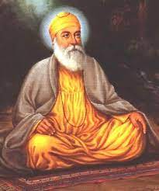
Guru Nanak What are the 3 central teachings of Guru Nanak?
Developed during a time when the sant (“holy people”) were challenging conventional religious practices
North Indian poets who rejected most outward forms of ritual expression in favor of deep internal devotion and repetition of the name of God
Critical of caste distinctions.
Guru Nanak (1469–1539): envisioned an organized community

Slide 56
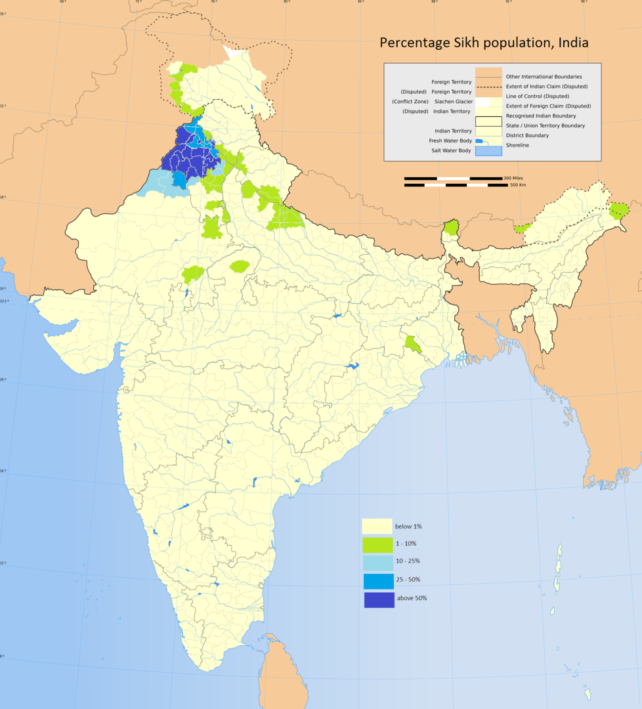
Guru Nanak What are the 3 central teachings of Guru Nanak?
Punjabi context
Muslims & Hindus
Invasions from outside the subcontinent come through this area
1398 Tamerlane’s slaughter of Punjabis
During Guru Nanak’s life Mughal emperor Babur’s claim of Punjab
Perpetual battleground

Slide 57
Guru Nanak What are the 3 central teachings of Guru Nanak?
Life of Guru Nanak
Known through janam-sakhis (traditional life-stories) written in 16th century, 17th-20th
Not historical records
Reflect the biases and concerns of their times, such as early 17th century opposition to the ritualism of Brahmanic Hinduism
Recount many miraculous happenings that cannot be historically verified
Contemplative nature; not concerned with worldly things
Accountant by trade

Slide 58
Guru Nanak What are the 3 central teachings of Guru Nanak?
Life of Guru Nanak
Age of 30: transformative experience
Reportedly transformed after immersion in a river, from which it is said he did not emerge for 3 days
one account –taken into the presence of God, who gave him a bowl of milk to drink, saying that it was actually nectar (amrit) which would give him “power of prayer, love of worship, truth and contentment.”
Redemption from the Kali Yuga (darkest of ages)
Rich in symbolic meaning
Began traveling through India, the Himalayas, Afghanistan, Sri Lanka, and Arabia, teaching in his way
Notes:
The word “sakhi” means evidence—evidence of some truth in the form of a story. ... First of all the legend signifies that in order to attain the Lord, one is required to drown—drown in love and devotion and into the depths of meditation. ... The second requirement is to die—die towards the world. Our relationship with the world is ego-oriented and selfnourishing. Such orientation does not permit one to become oriented towards God. Breaking one’s bonds with the world signifies the symbolic death in the legend. The third symbol is that of returning. One who loses himself in himself, returns renewed. When he dives, he is a seeker. When he emerges, he is a seer— impregnated with the Beatific Vision. He has been saved. Now he has the task of salvaging others.

Slide 59
Guru Nanak What are the 3 central teachings of Guru Nanak?
Life of Guru Nanak
“There is neither Hindu nor Mussulman [Muslim], so whose path shall I follow? I shall follow God’s path. God is neither Hindu nor Mussulman.”
Mocked Hindu & Muslim rituals
Notes:
The word “sakhi” means evidence—evidence of some truth in the form of a story. ... First of all the legend signifies that in order to attain the Lord, one is required to drown—drown in love and devotion and into the depths of meditation. ... The second requirement is to die—die towards the world. Our relationship with the world is ego-oriented and selfnourishing. Such orientation does not permit one to become oriented towards God. Breaking one’s bonds with the world signifies the symbolic death in the legend. The third symbol is that of returning. One who loses himself in himself, returns renewed. When he dives, he is a seeker. When he emerges, he is a seer— impregnated with the Beatific Vision. He has been saved. Now he has the task of salvaging others.

Slide 60
Guru Nanak What are the 3 central teachings of Guru Nanak?
Guru Nanak’s three central teachings as the straight path to God
Work hard in society to earn one’s own honest living (instead of withdrawing into asceticism and begging, as was the practice of many yogis of his time)
Share one’s earnings with the needy
Remember God at all times as the only Doer, the only Giver

Slide 61
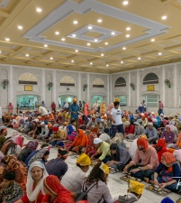
Guru Nanak What are the 3 central teachings of Guru Nanak?
Encouraging people to stay in the world and to help others rather than renounce the world in search of spiritual fulfillment, Guru Nanak himself settled with his family as a farmer in the new community he developed at Kartarpur (Town of the Creator)
langar: free community kitchen in which there were no caste distinctions

Slide 62
Guru Nanak What are the 3 central teachings of Guru Nanak?
Encouraged Sikhs to live a disciplined life of rising early in the morning to praise God and working hard to support themselves and share with those in need
Guru Nanak introduced idea of a social order based on equality, justice, and service in devotion to the One God, whom Guru Nanak perceived as formless, pervading everywhere
Commitment to practical faith, as opposed to external adherence to religious formalities, won him followers from both Hinduism and Islam

Slide 63
Guru Nanak What are the 3 central teachings of Guru Nanak?
Before he died, they argued over who would dispose of his body. According to the janam-sakhis, he told Muslims to place flowers on one side of his body, Hindus on the other; the side whose flowers remained fresh the next day could bury or cremate him. The next day they raised the sheet that had covered his body and reportedly found nothing beneath it; all the flowers were still fresh, leaving only the fragrance of his being.

Slide 64
11.2 Summarize the development of Sikhism during the time of the Gurus
There were eventually ten Sikh Gurus, all of whom were thought to be transmitting the spiritual light of Nanak. The Third and Fourth Gurus, Amar Das (1479–1574) and Ram Das (1534–1581), developed organized structures for the growing Sikh Panth (community). Ram Das founded the holy city of Amritsar, within which the Fifth Guru, Guru Arjun Dev (1563–1606) built the religion’s most sacred shrine, the Golden Temple. The Fifth Guru also compiled the sacred scriptures of the Sikhs, the Adi Granth, now known as the Guru Granth Sahib.

Slide 65
11.2 Summarize the development of Sikhism during the time of the Gurus
To protect Sikhism against the Mughals and to defend the weak of all religions against tyranny, the Sixth Guru, Hargobind (1595–1644), established a Sikh army. The Tenth Guru, Guru Gobind Singh (1666–1708), called his initiates Khalsa (Pure Ones), a community pledged to a special code of personal discipline. They were sworn to wear five distinctive symbols of their dedication (Five Ks): unshorn hair, a comb to keep it tidy, drawstring underbreeches for modesty, a small sword in a sheath, and a steel bracelet. Guru Gobind Singh ended the line of bodily succession to Guruship by transferring his authority to the Adi Granth and the panth.

Slide 66
The succession of the Gurus
How did the activities of the Sikh Gurus help structure and shape the Sikh community and its practices?

Slide 67
The succession of the Gurus
2nd Guru Angad (“limb of his body”) (1504–1552)
Guru Nanak passed his spiritual authority to Lehna, who was renamed Guru Angad
Famous for healing incurable diseases such as leprosy, Guru Angad was a model of humility and service to the poor and needy.
Continued the tradition of langar and served the people with his own hands.
Established precedent of succession

Slide 68
The succession of the Gurus
3rd Amar Das (1479–1574): organized the Sikh Panth (community)
4th Ram Das (1534–1581): founded holy city of Amritsar
These two gurus developed organizational structures for the growing Sikh Panth (community) while also setting personal examples of humility
Ram Das founded the holy city of Amritsar

Slide 69
The succession of the Gurus
5th Arjun Dev (1563–1606)
Built the Golden Temple in Amritsar (most sacred shrine)
Compiled the Adi Granth (“original holy book,” a.k.a. Guru Granth Sahib)
from devotional hymns composed by Guru Nanak, the other Gurus, and Hindu and Muslim saints, including many spiritual figures from social castes considered lowly.
Emperor Akbar visited the Third, Fourth, and Fifth Gurus and was pleased with the teachings of the Gurus
Executed by Emperor Jehangir who was jealous of Guru Arjun Dev’s popularity among Muslims
Had him tortured and executed in 1606 on a false charge

Slide 70
The succession of the Gurus
6th Hargobind (1595–1644)
To protect Sikhism and to defend the weak of all religions against tyranny
Established a Sikh army, carried two swords (one symbolizing temporal power, the other spiritual power)
Taught the people to defend their religion

Slide 71
The succession of the Gurus
7th Har Rai (1630–1661)
Pacifist who never used his troops against the Mughals
Taught his Sikhs not only to feed anyone who came to their door, but also to:
“do service in such a way that the poor guest may not feel he is partaking of some charity but as if he had come to the Guru’s house which belonged to all in equal measure. He who has more should consider it as God’s trust and share it in the same spirit. Man is only an instrument of service: the giver of goods is God, the Guru of us all.”

Slide 72
The succession of the Gurus
8th Har Krishan (1656–1664)
Appointed at 5 years old and died at age of 8
When taunted by Hindu pandits (teacher-scholars) the “Child Guru” reportedly touched a lowly deaf and dumb Sikh watercarrier with his cane, whereupon the watercarrier expounded brilliantly on the subtleties of the Hindu scripture the Bhagavad-Gita

Slide 73
The succession of the Gurus
9th Tegh Bahadur (c. 1621–1675)
Martyred by Emperor Aurangzeb
Approached by Kashmiri Hindu pandits who were facing forced conversion to Islam by the Mughal emperor, Aurangzeb
Viewed Hinduism as a totally corrupt, idolatrous religion, which did not lead people to God
Ordered the destruction of Hindu temples and mass conversion of Hindus throughout the land
Guru Tegh Bahadur told the Hindu pandits to inform their oppressors that they would convert to Islam if the Sikh Guru could be persuaded to do so
Imprisoned and forced to witness the torture and murder of his aides, the Ninth Guru staunchly maintained the right of all people to religious freedom.

Slide 74
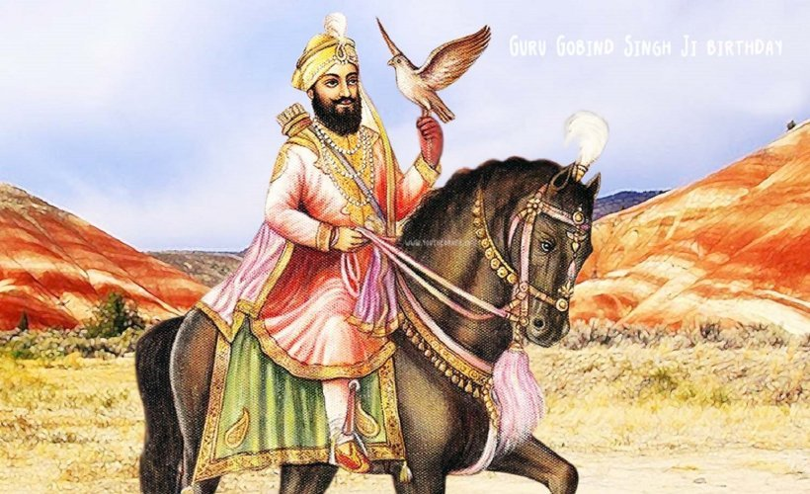
The succession of the Gurus
Gobind Singh (1666–1708)
Young son of Tegh Bahadur
Initiated saint-soldiers; Five Beloved Ones were first from lowest classes
Then he had them initiate him (equality)

Slide 75
The succession of the Gurus
Gobind Singh (1666–1708)
amrit: nectar-like holy water consumed by initiates prepared by Guru Gobind Singh is thought to have turned his followers into heroes, with sugar added by his wife symbolizing the ideal that they would also be compassionate
Founded the Khalsa in response to the the martyrdom of the Ninth Guru
Initiates (Khalsa, or Pure Ones) given new surnames
Men: Singh (lion)
Women: Kaur (princess)
Treated as equals

Slide 76
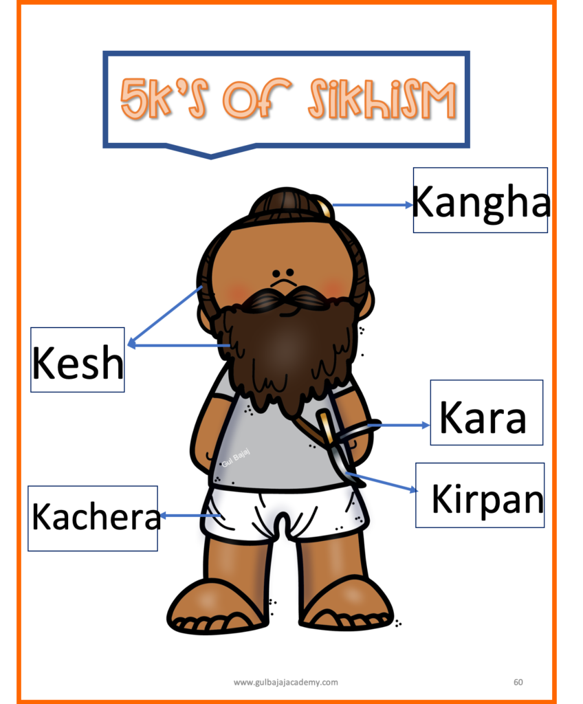
Succession of the Gurus Five Ks: 5 distinctive symbols of dedication
(all begin with the letter K in Punjabi)
Uncut hair
Comb
Drawstring underbreeches
Sword in a sheath
Steel bracelet
Notes:
supporting the assertion that Sikhism constituted a third path with its own right to spiritual sovereignty. All of these innovations are thought to have turned the meek into warriors capable of shaking off Mughal oppression and protecting freedom of religion; the distinctive dress made it impossible for the Khalsa to hide from their duty by blending with the general populace. In Sikh history, their bravery was indeed proven again and again.

Slide 77
Succession of the Gurus Five Ks: 5 distinctive symbols of dedication
Many explanations for what they symbolize
Uncut hair
Not cutting one’s hair shows respect for what God created
Comb
Keeping it neat with the comb distinguishes the Sikh from Hindu renunciates who let their unshorn hair grow long and matted
Drawstring underbreeches
Ensure modesty, and were also practical for Sikhs riding horses in battle
Sword in a sheath
Symbolizes the willingness to stand up for justice and protection of the weak
Steel bracelet
Worn as a personal reminder that one is a servant of God

Slide 78
Succession of the Gurus Five Ks: 5 distinctive symbols of dedication
Clearly distinguished Sikhs from Muslims & Hindus
By mandating the same symbolic dress for people of all castes, both women and men, Sikhs gave both genders and all castes equal importance, contrary to Indian cultural traditions
May also be significant spiritual symbols embedded in the Five Ks.
Notes:
supporting the assertion that Sikhism constituted a third path with its own right to spiritual sovereignty. All of these innovations are thought to have turned the meek into warriors capable of shaking off Mughal oppression and protecting freedom of religion; the distinctive dress made it impossible for the Khalsa to hide from their duty by blending with the general populace. In Sikh history, their bravery was indeed proven again and again.

Slide 79
Succession of the Gurus
Gobind Singh (1666–1708)
Appointed Adi Granth as next Guru in 1708
took the unique step of transferring his authority to the Adi Granth rather than to a human successor.
Now called the Guru Granth Sahib—the living presence of the Guru embodied in the sacred scripture, to be consulted by the congregation for spiritual guidance and decision-making.

Slide 80
Succession of the Gurus
Although the Sikh Gurus gave their followers no mandate to convert others, their message was spread in a nonsectarian way by the Udasis
Udasis: renunciates who do not withdraw from the world
Practice strict discipline and meditation while at the same time trying to serve humanity
Missionary work began under Baba Siri Chand, the ascetic elder son of Guru Nanak
Udasi communities and educational institutions are still maintained in the subcontinent

Slide 81
11.3 Outline what happened to Sikhism in India after the death of Guru Gobind Singh
As the Mughal Empire began to disintegrate in the eighteenth century and Afghans invaded India, the Sikhs fought for their own identity and sovereignty, as well as to protect freedom of religion in the country. They began establishing small states within the Punjab, and at the beginning of the nineteenth century these states were united under Maharaja Ranjit Singh, forming the Sikh Empire. This empire lasted only half a century, for the British, already in power throughout much of the rest of the India, subdued it in 1849.

Slide 82
Sikh Rule
Mughal Empire began to disintegrate and Afghans invaded India
Sikhs fought for their own identity and sovereignty, as well as to protect Hindu and Muslim women from the attackers, and to protect freedom of religion in the country
18th century, they began establishing small states within the Punjab, and at the beginning of the nineteenth century these states were united under Maharaja Ranjit Singh, forming the Sikh Empire, a nonsectarian government noted for its generous tolerance toward Muslims

Slide 83
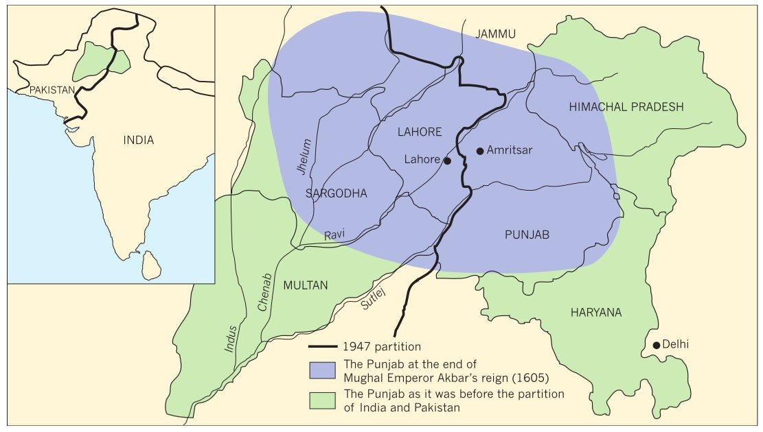
Sikh Rule

Slide 84
Sikh Rule
Attempted to create a pluralistic society, with social equality and full freedom of religion
It also blocked the Khyber Pass against invaders
The empire lasted only half a century, for the British, already in power throughout much of the rest of the India, subdued it in 1849

Slide 85
11.3 Outline what happened to Sikhism in India after the death of Guru Gobind Singh
The British left India in 1947, and the new nations of India and Pakistan were created. This partition profoundly affected Sikhs, with approximately two-thirds of the Punjab becoming part of West Pakistan. Two million Sikhs living there were forced to migrate to the eastern side of the border under conditions of extreme hardship, leaving behind land, possessions, and some of their most sacred sites.

Slide 86
Sikh rule and India’s independence movement
Why did resistance to oppression become a hallmark of Sikhism from 1700?
Sikhs made major contributions to Indian independence
Many were arrested, deported, or executed for their actions
Many Sikhs set heroic examples of nonviolent resistance to oppression, despite their military abilities

Slide 87
Sikh rule and India’s independence movement
Why did resistance to oppression become a hallmark of Sikhism from 1700?
One famous story concerns Guru ka Bagh, a garden and shrine that had been used by Sikhs for cutting wood for the community’s free kitchen. In 1922, British police began arresting and then beating and killing Sikhs who went to the garden to collect firewood. Every day a new wave of 100 Sikhs would come voluntarily to suffer fierce beatings and perhaps even be killed, without a murmur except for the Name of God on their lips, to resist injustice.

Slide 88
Sikh rule and India’s independence movement
Three Sikhs determined to feed Sikh political prisoners
Laid on train tracks at Hasanavdal to stop train
Asked sangat (congregation) to feed and care for prisoners
1947: Punjab partitioned into India and Pakistan
By 1948, as the great migration drew to a close, more than fifteen million people had been uprooted, and between one and two million were dead

Slide 89
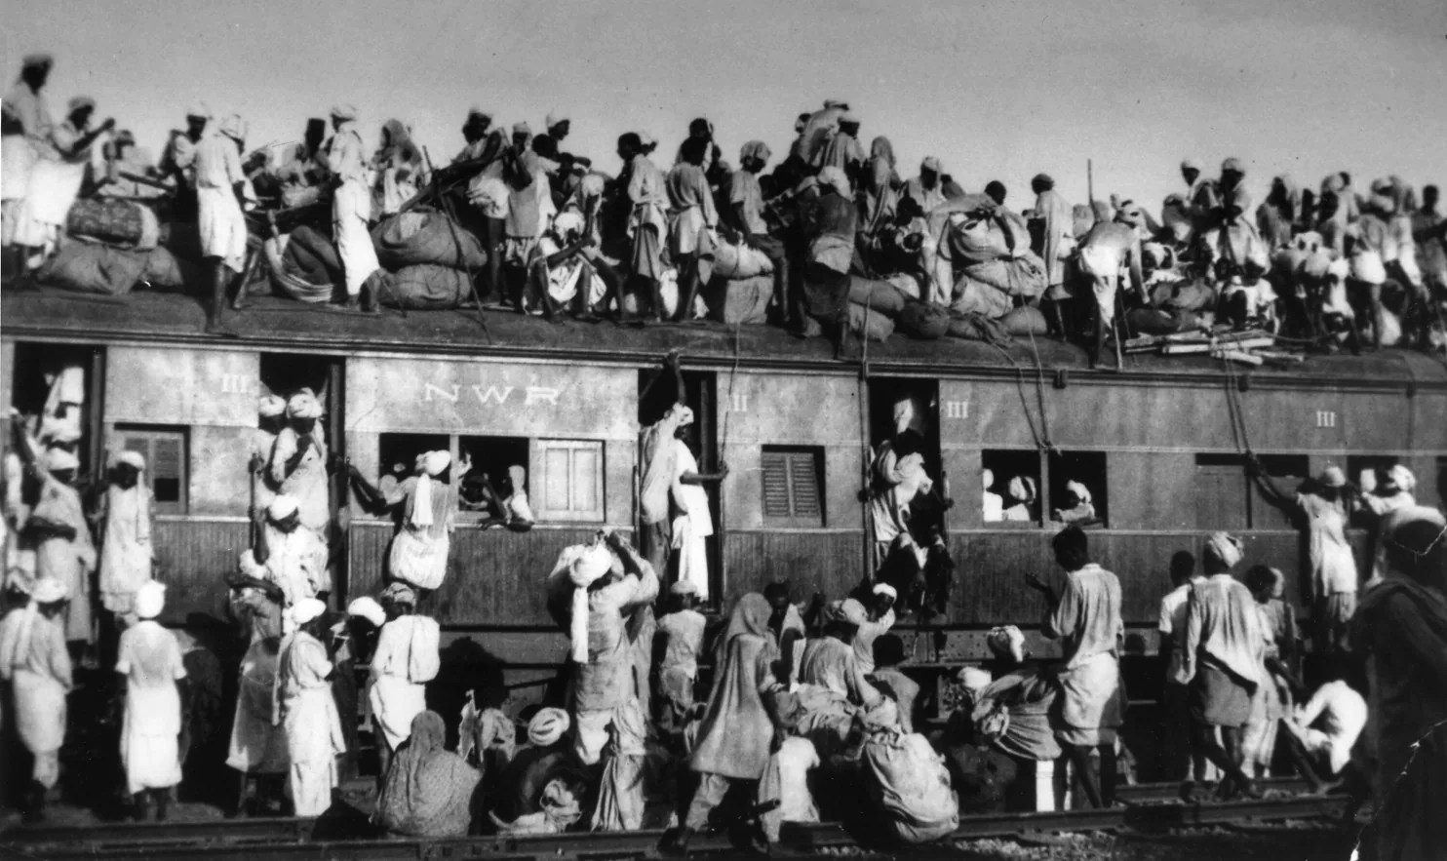
Muslims Board Train near New Delhi to flee India Sept. 1947

Slide 90
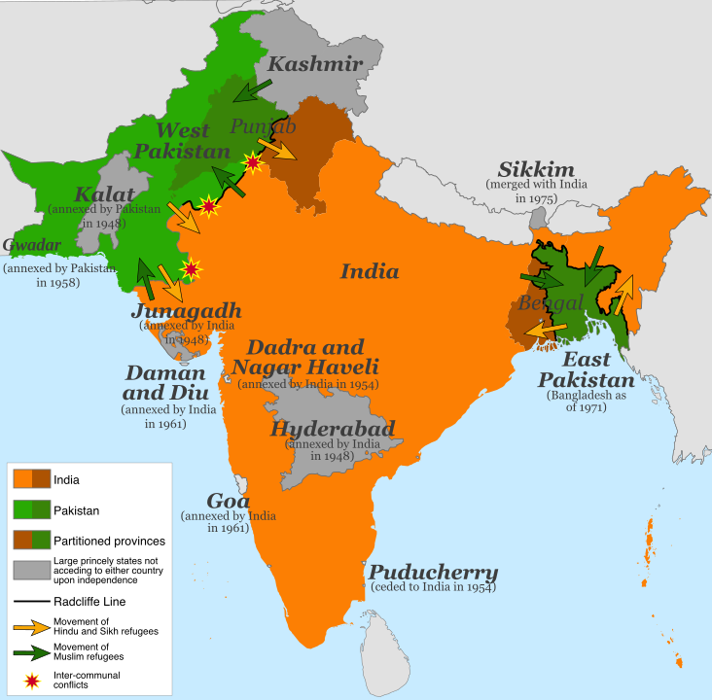
Map of after Partition Sikhs

